Slide 1

FYP1 PROPOSAL PRESENTATION
WORKSHOP | 8 DECEMBER 2023
SPEAKER:
DR. AHMAD FAIZ MOHAMMAD
SENIOR LECTURER
DEPARTMENT OF MECHANICAL PRECISION ENGINEERING

Slide 2

Outline
Presentation Rubric
Presentation Outline
Background & Motivation
Literature Review
Problem Statement & Objective
Methodology
Expected Outcome/Results, Analysis
Conclusions
Presentation Duration
Q&A

Slide 3
Presentation Rubric
Presentation (15%) | Criteria | Mark
Presentation (15%) | Topic Knowledge (Background and Literature Review) | 4
 | Technical Approach (Problem Statement, Objective and Methodology) | 4
 | Problem Solving Creativity (Methodology) | 3
 | Critical Thinking (Expected Outcome/Results, Analysis and Conclusions) | 2
 | Visual aids involving the use of diverse resources | 2
 | Total % | 15

Slide 4

Your Proposal Presentation Outline
FYP1
Background
Literature Review
Problem Statement
Objective
Methodology
Expected Outcome / Result
Result & Analysis
Conclusion
References
Can be included if there are any results or preliminary results
Can be drawn based on the outcome of related studies reviewed
(if no results obtained or no data collected yet)

Slide 5
Presentation vs. Report/Proposal
In ‘CHAPTER 1: INTRODUCTION’
Presentation | FYP1 Report/Proposal
Same with the report structure but presented in a slightly different order | 1.1 Background & Motivation 1.2 Problem Statement 1.3 Objective 1.4 Research Question 1.5 Scope & Limitation 1.6 Significance of Research

Slide 6

PART 1: BACKGROUND

Slide 7

1. BACKGROUND
1/6
In this section, you should present an overview of your study/project.
You should address the following:
What your project is about? [background of the project]
What is the current situation/atmosphere of the field of your study?
What motivates you (or other researchers in the same field) to undertake this study? [motivation of your study]
What makes your study relevant at present? [importance or significance of your study]

Slide 8
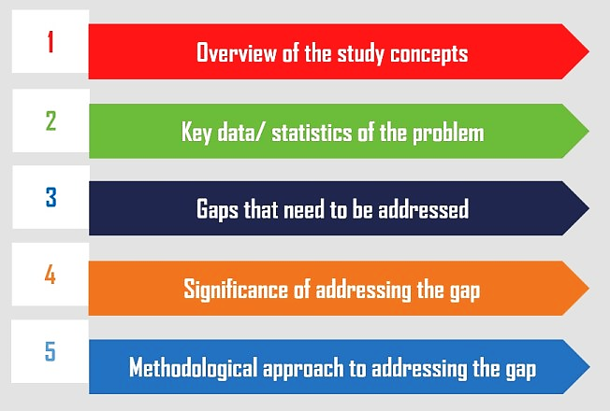
1. BACKGROUND
2/6
An ideal structure of the background of the study
Introduce main concepts & focus area of the study.
Introduce some key statistics pertaining to the main problem.
Explain what is lacking in the existing research. Bring focus on the main problem.
Establish the importance of the study.
Explain how the goal of the study will be achieved. Briefly mention about the methodology employed.
Source: https://www.projectguru.in/how-to-write-the-background-of-the-study-in-thesis-research/

Slide 9
1. BACKGROUND
3/6
A good background presentation should have:
1
One or two pictures that are relevant, large & clear (with a concise caption if needed). Always good to include the source of your picture.
2
Text with large font (> 16 pt) that captures keywords in your verbal explanation (text appears in parallel with your explanation).
3
Colours (less than five) for text or any visual aids displayed. Avoid using too many colours with font. Use bold to highlight important words or points.
4
Smart charts, graphics or tables to organize text (if necessary).
5
Strategic placement of contents (e.g. centered) with a balanced amount of white space. Avoid crowding your slide with text.

Slide 10
1. BACKGROUND
4/6
EXAMPLE
OF BACKGROUND PRESENTATION SLIDE

Slide 11
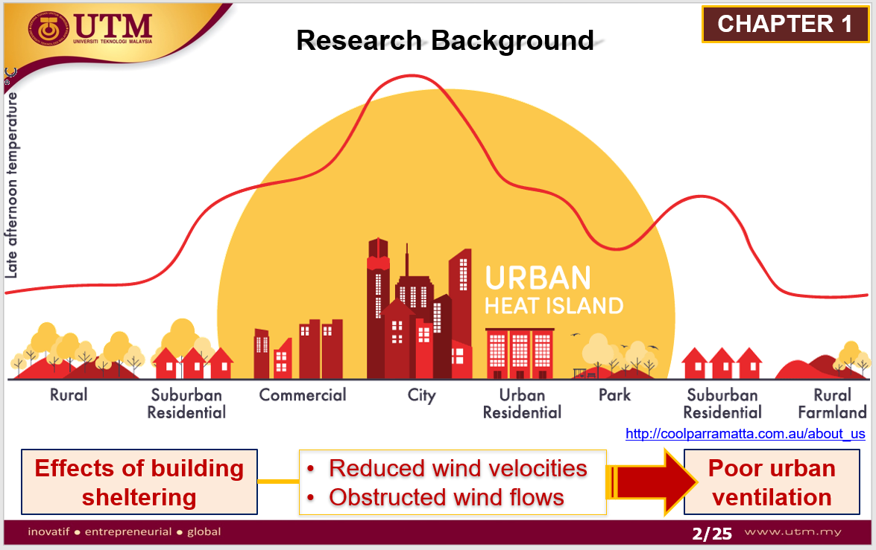
EXAMPLE

Slide 12
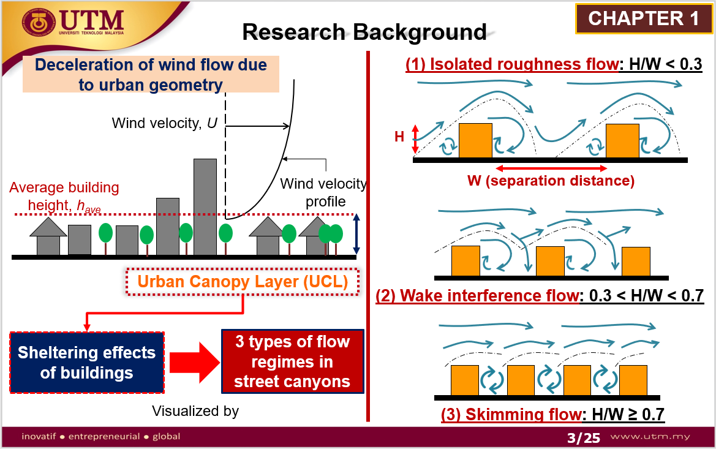
EXAMPLE

Slide 13

PART 2: LITERATURE REVIEW

Slide 14

2. LITERATURE REVIEW
1/7
To present the existing studies and findings on your research topic.
This means you are only relaying what already exists in the research world of your topic.
Reference:
Chapter 7 (Developing & Presenting Your Literature Review)

Slide 15
2. LITERATURE REVIEW
2/7
How to Develop Literature Review (LR)?
Purpose of study
List of selected literature (with theories)
Relevance of literature & theories
Identification of gaps
Knowledge gained up to latest literature /theories
Reference:
Write a Literature Review Introduction Sample - Your Example (wordsdoctorate.com)

Slide 16
How to Conduct Literature Review (LR)?
2. LITERATURE REVIEW
3/7
Trace the history of the specific fields & topics related to your study.
Cultivate familiarity with expertise in specific areas of knowledge, e.g. issues & debates in the field.
Become familiar with the specific vocabulary, terminology, and concepts in the field of interest.
Identify key theories or concepts related to the phenomenon and/or context of your study.
Identify factors and influences related to the phenomenon and/or context to be studied.
Identify limitations or gaps in specific fields from what the previous studies have found.
Reference:
Chapter 7 (Developing & Presenting Your Literature Review)

Slide 17
What is Important in Presenting Your LR?
2. LITERATURE REVIEW
4/7
A literature review requires a technical form of writing & presenting.
Facts must be documented
Opinions must be substantiated.
Sources used must be reliable i.e. academic papers, technical reports
Must cite your sources – including for figures, quotes, results etc.
Be concise when presenting your LR.
Use tables and bullet points – not paragraphs!
Highlight latest & most important findings first.
Conclude your LR with a summary to explain the research gap:
What is lacking in previous studies?
What needs to be improved?
What needs to be done differently?
Main Sources
Use latest sources more (< 5 years)
Reference:
Chapter 7 (Developing & Presenting Your Literature Review)

Slide 18
2. LITERATURE REVIEW
5/7
EXAMPLE
OF LITERATURE REVIEW PRESENTATION SLIDE

Slide 19
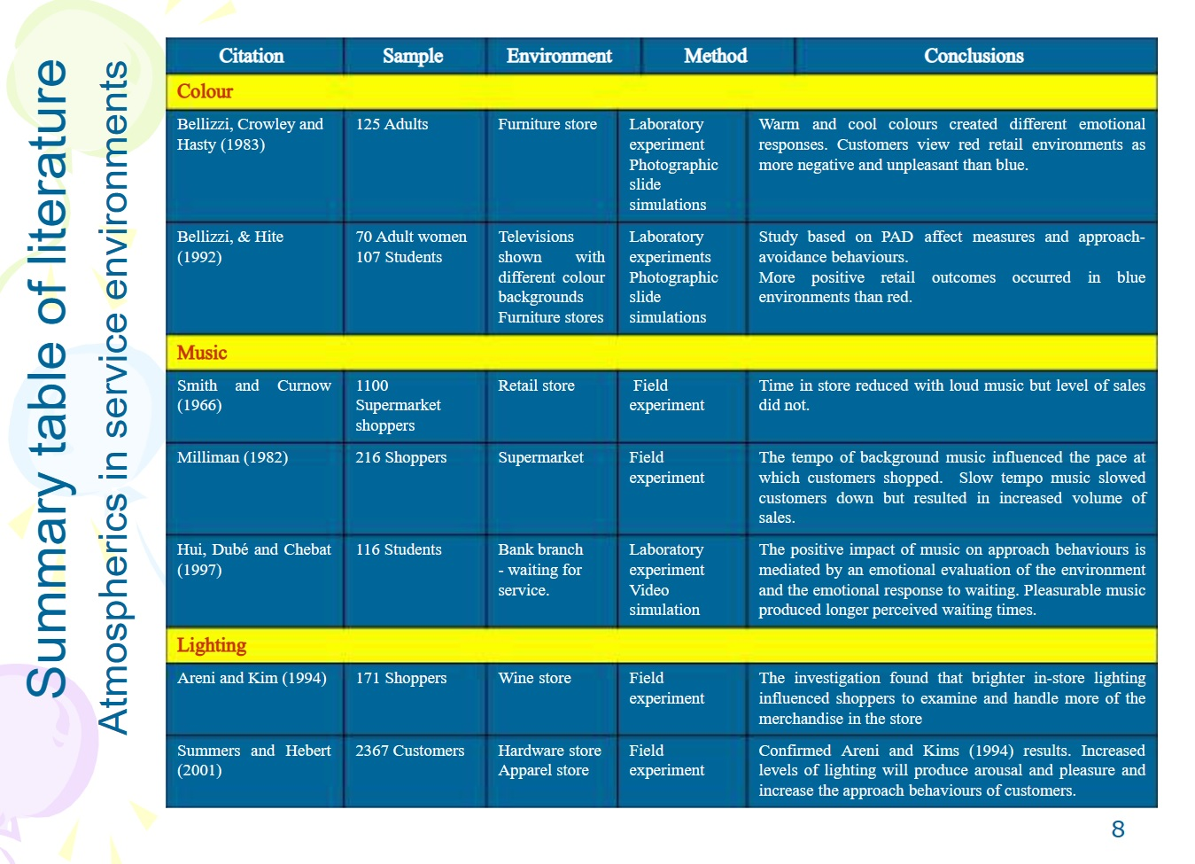
EXAMPLE
In your LR table,
Separate the table into more than one slide (depending on the number of entries in the table)
Use a bigger font (≥ 16 pt)
Source:
Writing and Presenting Literature Review - ppt download (slideplayer.com)

Slide 20
2. LITERATURE REVIEW
7/7
A good literature review is…
FOCUSED
INTEGRATIVE
The topic should be narrow & only report studies that are closely related to topic.
CONCISE
LOGICAL & SEQUENTIAL
CURRENT
DEVELOPED
The review should focus on work being done on the cutting edge of your topic.
Ensure that the ideas or concepts in your study are integrated (connected) to each other.
Ideas should be presented concisely (avoid long explanation).
The presentation must be in logical or sequential order – e.g. from more recent to less recent.
Ensure your LR is presented up to the gap. Don’t leave your story half told!

Slide 21

PART 3: PROBLEM STATEMENT & OBJECTIVE

Slide 22
What is Problem Statement?
3. PROBLEM STATEMENT & OBJECTIVE
1/3
A problem statement is a concise and concrete summary of the research problem you seek to address.
It should:
Contextualize the problem. What do we already know?
Describe the exact issue your research will address. What do we still need to know?
Show the relevance of the problem. Why do we need to know more about this? What will happen if the problem is not solved? Who will feel the consequences? Does the problem have wider relevance? Are similar issues found in other contexts?
Set the aim of the research. The research aim is the overall purpose of your research. What will you do to find out more?

Slide 23
What is Objective?
3. PROBLEM STATEMENT & OBJECTIVE
2/3
The research objectives are the concrete steps you take to achieve the aim.
State at least two objectives – must be clear and concise
Use appropriate verbs to accurately convey the work that you will carry out for each one:
Specific –Clearly state an objective using ‘action’ verbs
Measurable – Ensure the outcome can be measured.
Achievable – The objective is realistic given your resources (e.g., time, money, people).
Relevant – Set the objective relevant to the scope of your study.
Time-Bound – Ensure there is a specific timeline or deadline for when the objective should be accomplished.
S
M
A
R
T
Source:
Using Smart Objectives to Manage Your Database

Slide 24
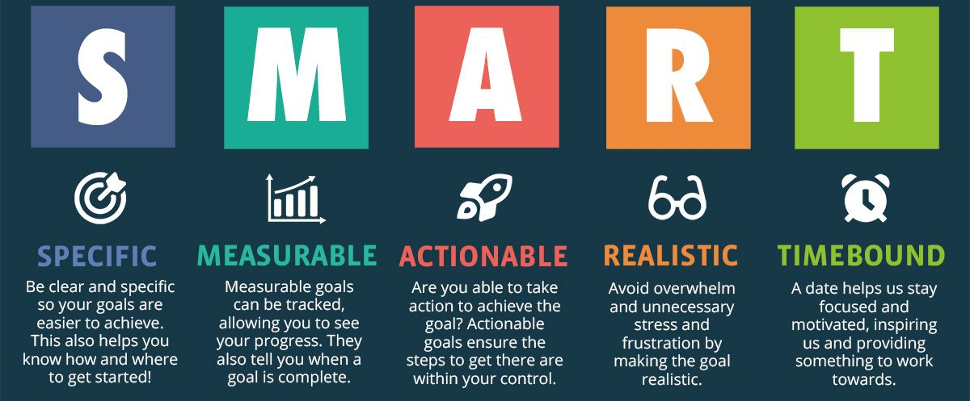
SMART objectives can be applied anywhere in your life, both professionally & personally.
3. PROBLEM STATEMENT & OBJECTIVE
3/3
Source:
Free SMART Goals Guide for Coaches (plus .PDF) | The Launchpad - The Coaching Tools Company Blog

Slide 25

PART 4: METHODOLOGY

Slide 26
What is Research Methodology?
4. METHODOLOGY
1/4
The systematic method to resolve a research problem through data gathering using various techniques, providing an interpretation of data gathered and drawing conclusions about the research data.
A research methodology is the blueprint of a research or study
(Murthy & Bhojanna, 2009, p. 32).
Reference:
How to Write Research Methodology: Overview, Tips, and Techniques

Slide 27
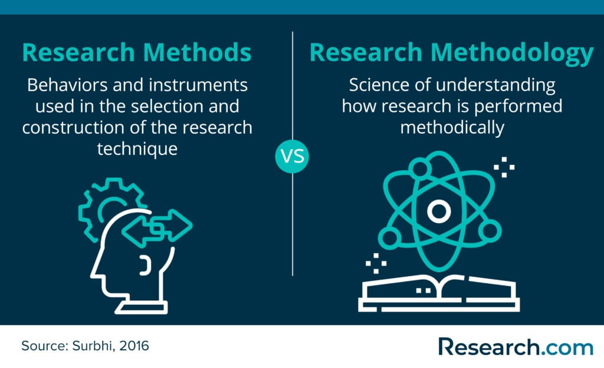
What is Research Methodology?
4. METHODOLOGY
2/4
Reference:
How to Write Research Methodology: Overview, Tips, and Techniques

Slide 28
How to Present Your Research Methodology?
4. METHODOLOGY
3/4
Restate your research problem.
Describe & justify your selected approach.
Explain the methods of your data collection.
Describe your data analysis method.
Explain the obstacles and their solutions.
Provide citations of sources.
Don’t forget to use visual aids!
Flow chart, table, diagrams, images etc.
Reference:
How to Write Methodology?

Slide 29

PART 5: EXPECTED OUTCOME / RESULT

Slide 30
5. EXPECTED OUTCOME / RESULT
1/2
If you don’t have any preliminary results, present your hypothetical findings based on scientific or statistical evidences found in reviewed studies.
Each objective must be accompanied with at least one expected outcome supported by evidences found in LR.
Ideally, use graphs or charts to describe your expected outcome.

Slide 31
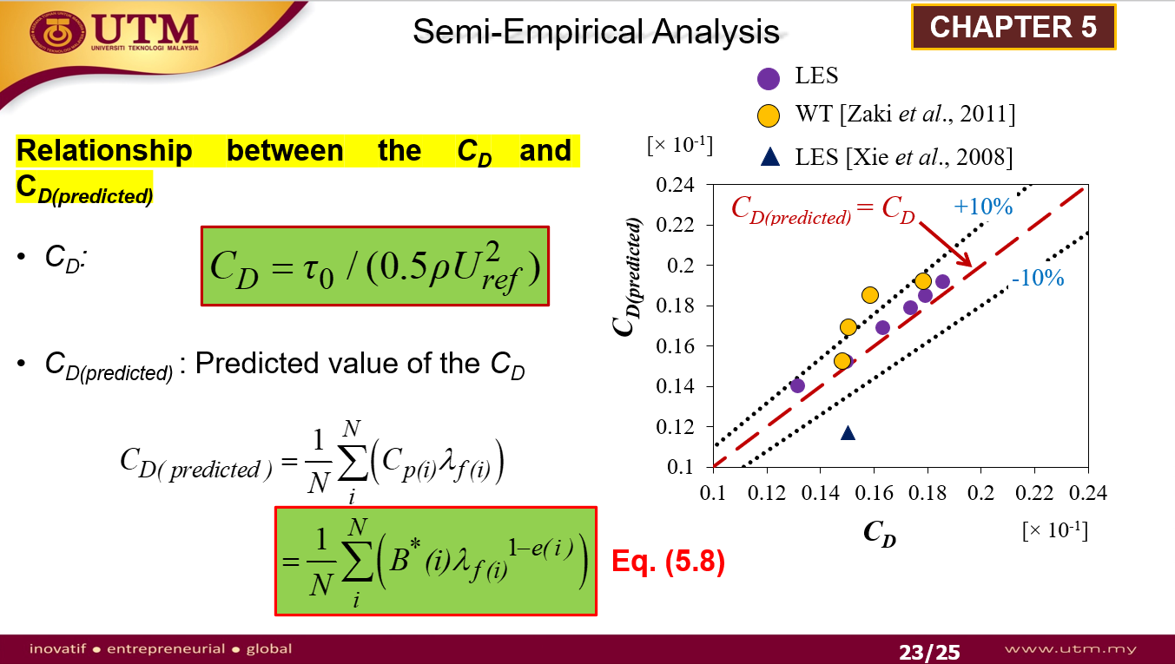
EXAMPLE
EXPECTED RESULT

Slide 32

PART 6: CONCLUSION

Slide 33
6. CONCLUSION
1/2
Conclusion is an essential part of your presentation.
It serves to highlight the key points presented earlier & conclude the presentation.
Present conclusions based on:
Your preliminary findings or
Any work that has been completed or
Findings that have been reviewed in past studies.
Don’t forget to include another slide containing all references cited in the presentation slides.

Slide 34
Use Allotted Presentation Time Wisely
No. | Section | Suggested Duration (min)
1 | Background and Literature Review | 3
2 | Problem Statement, Objective | 2
3 | Methodology | 3
4 | Expected Outcome/Results, Analysis and Conclusions | 2
 | TOTAL TIME | 10

Slide 35
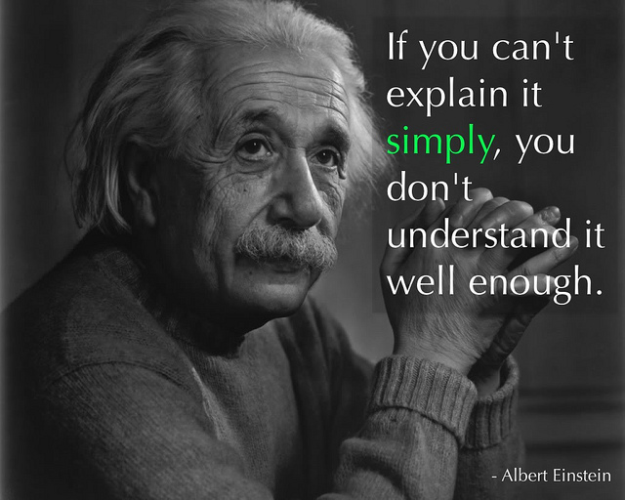

Slide 36
Any Questions?

Slide 37

THANK YOU & GOOD LUCK!
In the Name of God for Mankind
univteknologimalaysia
utm.my
utmofficial

